Slide 1
JavaScript
Module 4

Slide 2
1. Origins
JavaScript, was developed by Netscape, originally named Mocha but soon was renamed LiveScript
1995 LiveScript became a joint venture of Netscape and Sun Microsystems , renamed as JavaScript
A language standard for JavaScript-ECMA-262.
ECMA latest verison is 7. widely used is ECMA version 3

Slide 3
JavaScript can be divided into three parts:
The core is the heart of the language, including its operators, expressions, statements, and subprograms
Client-side JavaScript-collection of objects that support the control of a browser and interactions with users
Server-side JavaScript- collection of objects that make the language useful on a Web server

Slide 4
1.1 JavaScript and Java
Difference
JavaScript does not support the object-oriented software development paradigm.
Java is a strongly typed language- Types are all known at compile time, and operand types are checked for compatibility
Variables in JavaScript need not be declared and are dynamically typed
objects in Java are static in the sense that their collection of data members and methods is fixed at compile time.
JavaScript objects are dynamic: The number of data members and methods of an object can change during execution.
main similarity- in the syntax of their expressions, assignment statements, and control statements

Slide 5
1.2 Uses of JavaScript
to provide programming capability at both the server and the client ends of a Web connection
transfer of load from the often overloaded server to the often underloaded client
Interactions with users through form elements, such as buttons and menus
Document Object Model (DOM), allows JavaScript scripts to access and modify the CSS properties and content of the elements of a displayed XHTML document

Slide 6
2. Object Orientation and JavaScript
JavaScript is an object-based language.
JavaScript does not have classes
JavaScript cannot have class-based inheritance
support a technique that can be used to simulate some of the aspects of inheritance- prototype-based inheritance
JavaScript cannot support polymorphism

Slide 7
3. General Syntactic Characteristics
JavaScript scripts are embedded, either directly or indirectly, in XHTML documents.
Scripts can appear directly as the content of a <script> tag.
The type attribute of <script> must be set to “text/javascript”.
The JavaScript script can be indirectly embedded in an XHTML document with the src attribute of a <script> tag, whose value is the name of a file that contains the script
<script type = “text/javascript” src = “tst_number.js” >
</script>

Slide 8
JavaScript scripts can appear in either part of an XHTML document—the head or the body
scripts that produce content only when requested or that react to user interactions are placed in the head of the document.
scripts that are to be interpreted just once, when the interpreter finds them, are placed in the document body
In JavaScript, identifiers, or names must begin with a letter, an underscore ( _ ), or a dollar sign ($).
There is no length limitation for identifiers.
variable name in JavaScript are case sensitive

Slide 9
JavaScript has two forms of comments,
two adjacent slashes (//)
/* may be used to introduce a comment, and */ to terminate

Slide 10
Two issues arise regarding embedding JavaScript in XHTML documents
some browsers that are still in use recognize the <script> tag but do not have JavaScript interpreters.
these browsers simply ignore the contents of the script element and cause no problems
a few browsers that are still in use are so old that they do not recognize the <script> tag.
Such browsers would display the contents of the script element as if it were just text.
enclose the contents of all script elements in XHTML comments to avoid this problem.

Slide 11

The HTML comment used to hide JavaScript has the following syntax:
HTML comment form hides the enclosed script from browsers that do not have JavaScript interpreters, but makes it visible to browsers that do support JavaScript

Slide 12
4. Primitives, operations and expressions 1.Primitive types
JavaScript has five primitive types: Number, String, Boolean, Undefined, and Null.
JavaScript includes predefined objects- Number, String, and Boolean
These objects are called wrapper objects.
The purpose of the wrapper objects is to provide properties and methods that are convenient for use with values of the primitive types.

Slide 13
2. Numeric and String Literals
Number values are represented internally as double-precision floating-point values
Number literals can be either integer or float
Float values may have a decimal and/or and exponent
A String literal is delimited by either single or double quotes
There is no difference between single and double quotes
Certain characters may be escaped in strings
\’ or \” to use a quote in a string delimited by the same quotes
\\ to use a literal backspace
The empty string ‘’ or “” has no characters

Slide 14
3. Other Primitive Types
Null
A single value, null
null is a reserved word
A variable that is used but has not been declared nor been assigned a value has a null value
Using a null value usually causes an error
Undefined
A single value, undefined
However, undefined is not, itself, a reserved word
The value of a variable that is declared but not assigned a value
Boolean
Two values: true and false

Slide 15
4. Declaring Variables
JavaScript is dynamically typed, that is, variables do not have declared types
A variable can hold different types of values at different times during program execution
Variables are not typed; values are.
A variable can have the value of any primitive type, or it can be a reference to any object.
Interpreter converts the type of a value to whatever is needed for the context in which it appears.
A variable can be declared using the keyword var
var counter,
index,
pi = 3.14159265,
quarterback = "Elway",
stop_flag = true;

Slide 16
5.Numeric Operators
Standard arithmetic
+ * - / %
Increment and decrement
-- ++
Increment and decrement differ in effect when used before (prefix)and after (postfix) a variable
Assume that a has the value 7, initially
(++a) * 3 has the value 24
(a++) * 3 has the value 21
a has the final value 8 in either case

Slide 17
precedence rules:
specify which operator is evaluated first when two operators with different precedence are adjacent in an expression.
associativity rules:
specify which operator is evaluated first when two operators with the same precedence are adjacent in an expression.

Slide 18
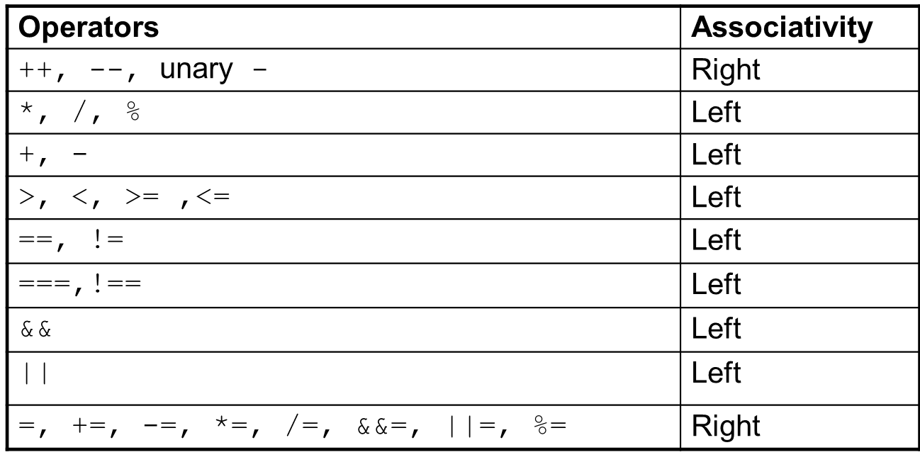
Unary +
The first operators listed have the highest precedence.

Slide 19
6. The Math Object
Provides a collection of properties and methods useful for Number values
This includes the trigonometric functions such as sin and cos
other commonly used mathematical operations
Floor :truncate a number;
Round :round a number; and
max :return the largest of two given numbers.
All of the Math methods are referenced through the Math object, as in Math.sin(x).

Slide 20
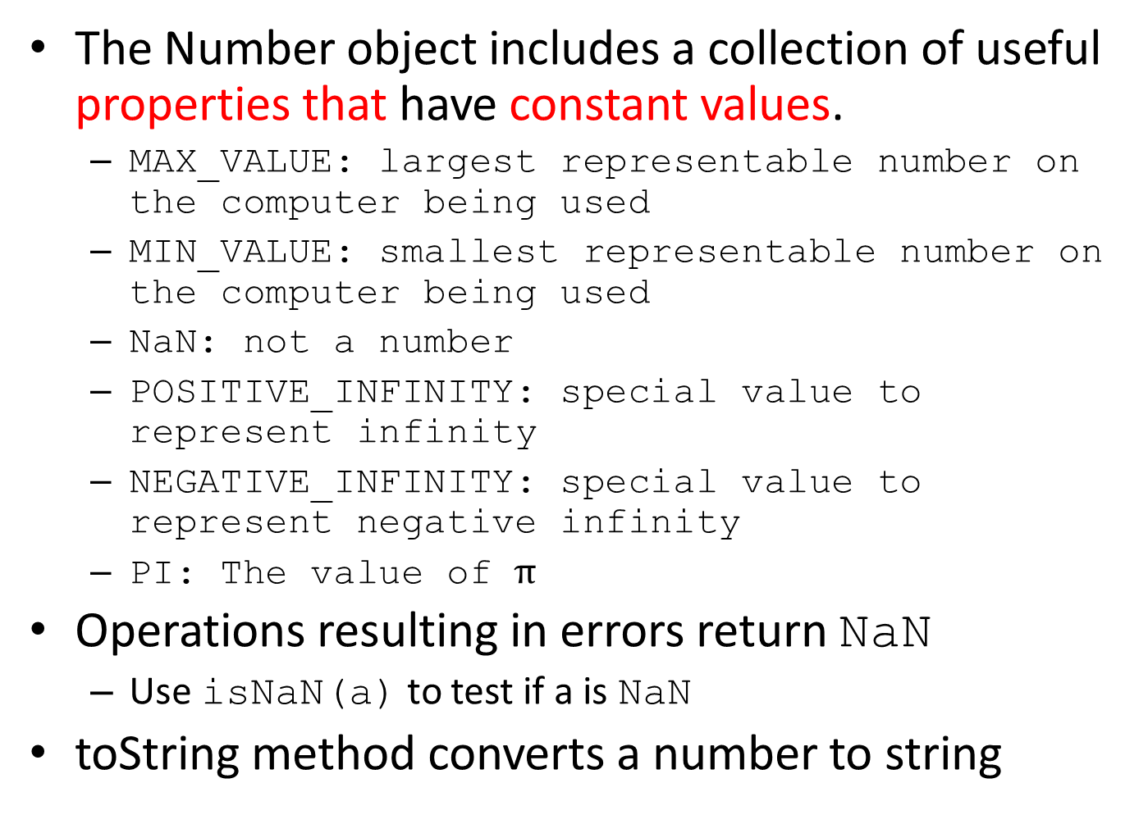
7. The Number Object
The Number object includes a collection of useful properties that have constant values.
MAX_VALUE: largest representable number on the computer being used
MIN_VALUE: smallest representable number on the computer being used
NaN: not a number
POSITIVE_INFINITY: special value to represent infinity
NEGATIVE_INFINITY: special value to represent negative infinity
PI: The value of $π$
Operations resulting in errors return NaN
Use isNaN(a) to test if a is NaN
toString method converts a number to string

Slide 21
8. The String Catenation Operator
JavaScript strings are not stored or treated as arrays of characters; rather, they are unit scalar values.
String catenation is specified with the operator denoted by a plus sign (+).
For example, if the value of first is “Engineering”
first + “ college”
the value of the expression is “Engineering college”

Slide 22
9. Implicit Type Conversions
JavaScript interpreter performs several different implicit type conversions called coercions.
JavaScript attempts to convert values in order to be able to perform operations
“August “ + 1977 causes the number to be converted to string and a concatenation to be performed
7 * “3” causes the string to be converted to a number and a multiplication to be performed
null is converted to 0 in a numeric context, undefined to NaN

Slide 23
10. Explicit Type Conversions
Strings that contain numbers can be converted to numbers with the String constructor
var str_value = String(value);
conversion could also be done with the toString method- parameter is used to specify the base of the resulting number
var num = 6;
var str_value = num.toString();
var str_value_binary = num.toString(2);
In the first conversion, the result is “6”; in the second, it is “110”.

Slide 24
Strings can be explicitly converted to numbers in several different ways.
One way is with the Number constructor
var number = Number(aString);
The same conversion could be specified by subtracting zero from the string, as in the following statement:
var number = aString - 0;

Slide 25
11. String Properties and Methods
The String object includes one property, length, and a large collection of methods.
The number of characters in a string is stored in the length property
var str = “George”;
var len = str.length;

Slide 26
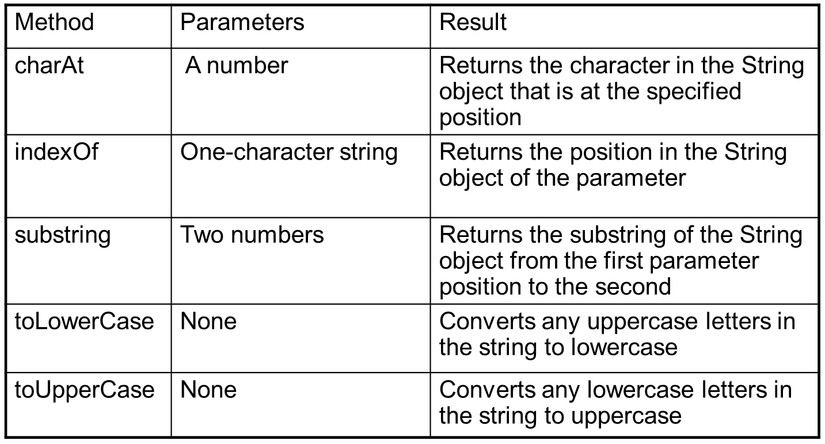
few of the most commonly used String methods are
for the String methods, character positions start at zero

Slide 27
12. The typeof Operator
The typeof operator returns the type of its single operand.
Returns “number” or “string” or “boolean” for primitive types
Returns “object” for an object or null
If the operand is a variable that has not been assigned a value, typeof produces “undefined”
Two syntactic forms
typeof x
typeof(x)

Slide 28
13. Assignment Statements
Plain assignment indicated by =
Compound assignment with
+= -= /= *= %= …
a += 7 means the same as
a = a + 7

Slide 29
14.The Date Object
A Date object represents a time stamp, that is, a point in time
A Date object is created with the new operator and the Date constructor
var now= new Date();
This creates a Date object for the time at which it was created

Slide 30
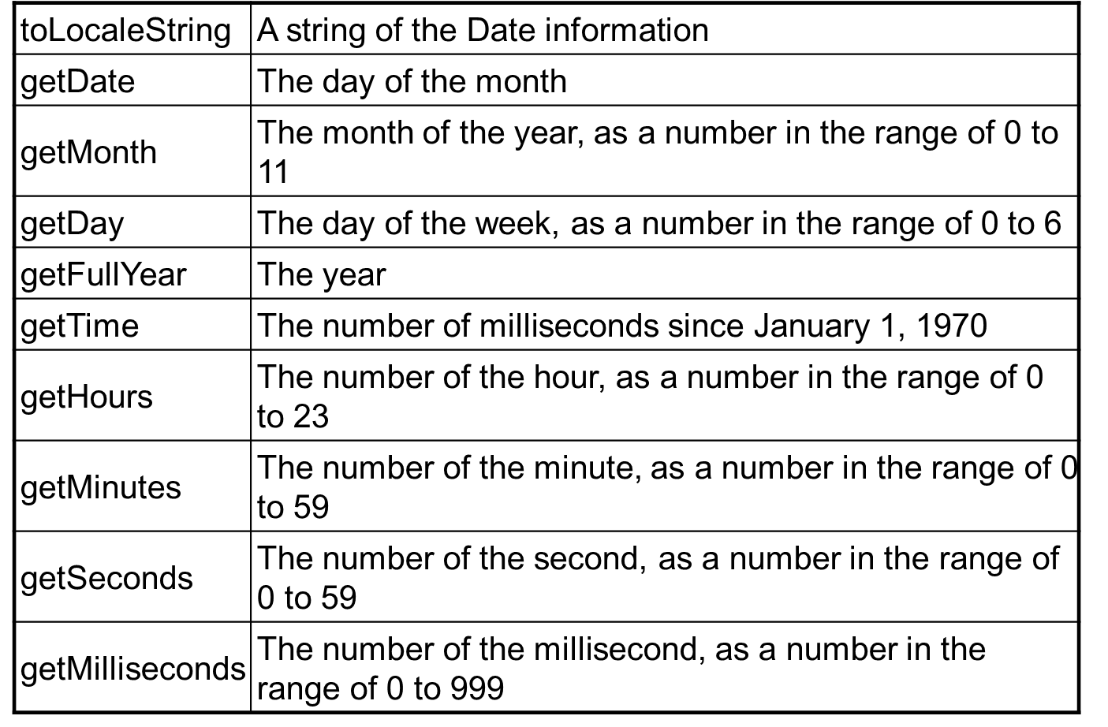
The Date Object: Methods

Slide 31
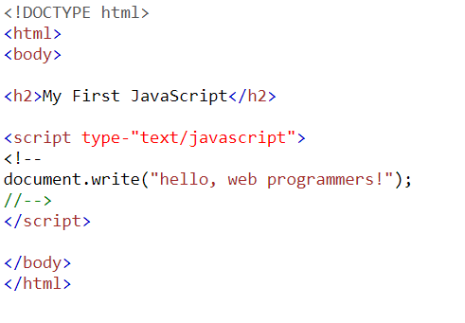
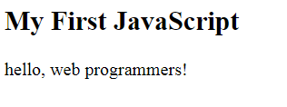
Simple JavaScript example

Slide 32
5. Screen Output and Keyboard Input
The normal output screen for JavaScript is the same as the screen in which the content of the host HTML document is displayed.
JavaScript models the HTML document with the Document object.
The window in which the browser displays an HTML document is modeled with the Window object.

Slide 33
5.1 Document object
The Document object has several properties and methods.
One method is write- used to create script output which is dynamically created HTML document content.
This content is specified in the parameter of write.
parameter of write can include any HTML tags and content.
Write method can take any number of parameters. Multiple parameters are concatenated and placed in the output.

Slide 34
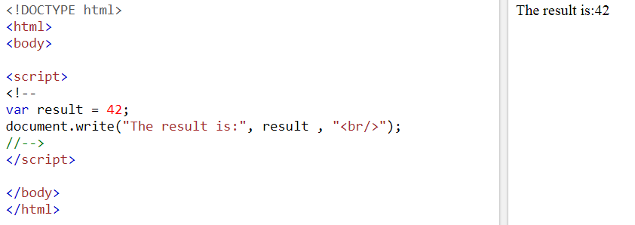

Slide 35
5.2 Window object
The Window object is the JavaScript model for the browser window
Window includes three methods that create dialog boxes for three specific kinds of user interactions.
alert
confirm
prompt
Default object for JavaScript is the Window object- so calls to these methods need not include an object reference.

Slide 36
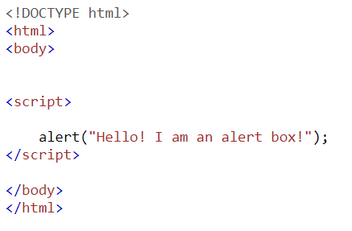
5.2.1 The alert method
The alert method opens a dialog window and displays its parameter in that window.
It also displays an OK button
alert.html

Slide 37
5.2.2 The confirm method
The confirm method opens a dialog window in which the method displays its string parameter
two buttons: OK and Cancel
confirm returns a Boolean value that indicates the user’s button input:
true for OK and false for Cancel.

Slide 38
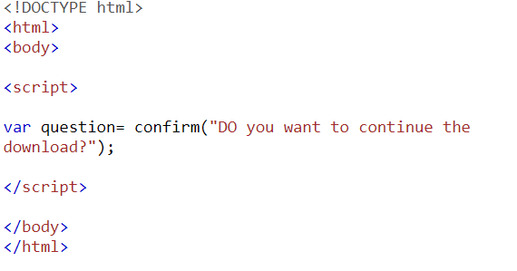
confirm.html

Slide 39
5.2.3 The prompt method
The prompt method creates a dialog window that contains a text box
used to collect a string of input from the user, which prompt returns as its value
two buttons: OK and Cancel
prompt takes two parameters: the string that prompts the user for input and a default string
In many cases, an empty string is used for the default input

Slide 40
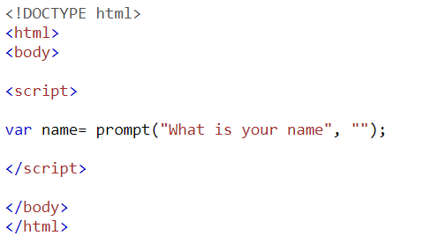
prompt.html
Example program: roots.html

Slide 41
6. Control Statements
compound statement in JavaScript is a sequence of statements delimited by braces.
A control construct is a control statement together with the statement or compound statement whose execution it controls.

Slide 42
6.1 Control Expressions
The expressions upon which statement flow can be controlled is based include primitive values, relational expressions, and compound expressions
The result of evaluating a control expression is one of the Boolean values true and false.
A relational expression has two operands and one relational operator
Comparison operators
== != < <= > >= === !==
Boolean operators
&&(AND) ||(OR) !(NOT)

Slide 43
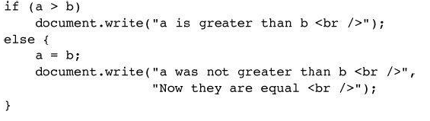
6.2 Selection Statements
selection statements (if-then and if-then-else)
Either single statements or compound statements can be selected

Slide 44
6.3 The switch Statement
JavaScript has a switch statement that is similar to that of Java.
switch (expression) {
case value_1:
// statement(s)
case value_2:
// statement(s)
...
[default:
// statement(s)]
}

Slide 45
6.4 Loop Statements
Loop statements in JavaScript are similar to those in C/C++/Java
While
while (control expression)
statement or compound statement
For
for (initial expression; control expression; increment expression)
statement or compound statement
do/while
do statement or compound statement
while (control expression)

Slide 46
7. Object Creation and Modification
Objects are often created with a new expression, which must include a call to a constructor method
The constructor creates the properties that characterize the new object.
the new operator creates a blank object(one with no properties)
JavaScript objects do not have types
The constructor both creates and initializes the properties.
var my_object = new Object();
statement creates an object that has no properties

Slide 47
The properties of an object can be accessed with dot notation
the first word is the object name and the second is the property name.
object_name.property_name
Properties are not actually variables—they are just the names of values ( need not to be declared)
They are used with object variables to access property values.
The number of properties in a JavaScript object is dynamic
properties can be added to or deleted from an object at any time during interpretation

Slide 48
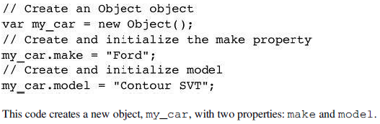
A property for an object is created by assigning a value to that property’s name
abbreviated way to create an object and its properties
var my_car = {make: “Ford”, model: “Contour SVT”};

Slide 49

objects can be nested - create a new object that is a property of my_car with properties of its own
First, any property can be accessed in the same way it is assigned a value
var prop1 = my_car.make;
Second, the property names of an object can be accessed as if they were elements of an array
var prop2 = my_car[“make”];
Properties can be accessed in two ways

Slide 50
An attempt to access a property of an object that does not exist, the value will be undefined .
A property can be deleted with delete
delete my_car.model;
JavaScript has a loop statement, for-in, that is perfect for listing the properties of an object
Syntax
for (identifier in object)
statement or compound statement

Slide 51
8. Arrays
arrays are objects that have some special functionality
Array elements can be primitive values or references to other objects, including other arrays.
JavaScript arrays have dynamic lengths.

Slide 52
8.1 Array Object Creation
Array objects, can be created in two distinct ways.
1. The usual way to create any object is with the new operator and a call to a constructor.
In the case of arrays, the constructor is named Array:
var my_list= new Array(1,2,”three”,”four”); // length 4
Var your_list= new Array(100); // length 100
Whenever a call to the Array constructor has a single parameter, that parameter is taken to be the number of elements

Slide 53
To create an Array object with a literal array value- list of values enclosed in brackets
var my_list_2 = [1, 2, “three”, “four”];

Slide 54
8.2 Characteristics of Array Objects
Access to the elements of an array is specified with numeric subscript expressions placed in brackets.
The length of an array= highest subscript to which a value has been assigned, plus 1.
The length of an array is both read and write accessible through the length property

Slide 55

8.3 Array Methods
join method
converts all of the elements of an array to strings and catenates them into a single string.
If no parameter is provided to join, the values in the new string are separated by commas.
If a string parameter is provided, it is used as the element separator.
The value of name_string is now “Mary : Murray : Murphy : Max”.

Slide 56

reverse method
It reverses the order of the elements of the Array object
sort method
Sorts elements of the array alphabetically
concat method
catenates its actual parameters to the end of the Array object
The value of new_names array is
“Mary”, ”Murray”, ”Murphy”, ”Max”, ”Moo”, ”Meow”

Slide 57


slice method
returning the part of the Array object specified by its parameters, which are used as subscripts.
from the first parameter up to, but not including, the second parameter.
The value of list2 is now [4, 6].
If slice is given just one parameter, the array that is returned has all of the elements of the object, starting with the specified index.
the value of listette is [“Jill”, “dill”].

Slide 58
The pop and push methods respectively remove and add an element to the high end of an array
The shift and unshift methods respectively remove and add an element to the beginning of an array.
A two-dimensional array is implemented in JavaScript as an array of arrays.
can be done with the new operator or with nested array literals

Slide 59
9. Functions
JavaScript functions are similar to those of other C-based languages, such as C and C++.
A function definition consists of the function’s header and a compound statement that describes the actions of the function.
compound statement is called the body of the function.
function header consists of the reserved word function, the function’s name, and a parenthesized list of parameters

Slide 60
A return statement returns control from the function
The scope of a variable is the range of statements over which it is visible.
Variables that are implicitly declared have global scope
Variables that are explicitly declared outside function definitions also have global scope.
variable explicitly declared with var in the body of a function has local scope.
If a variable that is defined both as a local variable and as a global variable appears in a function, the local variable has precedence

Slide 61
Parameters
actual parameters
parameter values that appear in a call to a function
formal parameters.
parameter names that appear in the header of a function definition
JavaScript uses the pass-by-value parameter-passing method

Slide 62
Thank you……

